Slide 1
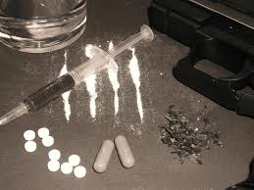
Substance Abuse A Clinical Perspective
Christopher Jimenez, LMHC
Laurie Sadofsky

Slide 2
Leading Off: Defining the problem
Substance use: Inappropriate consumption of medicines, drugs. Alcohol, over the counter and prescription drugs.
Substance Misuse: consuming enough of a substance to put one’s physical or mental health at risk.
Substance Abuse: using a substance in a maladaptive pattern resulting in significant impairment or distress (e.g. significant negative impact with Family, school/work or legal status)
Substance Dependence: clinically significant impairment or distress as manifested by 3 or more of the following clinical criteria: Tolerance, withdrawal symptoms, substance taken in larger amounts than intended, unsuccessful attempts at decreasing use, disproportionate amount of time is spent on accessing and taking substance, important activities (social, occupational) are sacrificed to engage in use and continued use despite the person’s knowledge of the negative physiological and psychological effects the substance is having on their life.

Slide 3
Risk Factors
Family history of substance use
Previous history of substance use
Untreated mental illness
Early stages of recovery
Increased social stressors
Unstable family situation (children in foster care, homelessness)
Lack of social support
Peer group
Access to substances in the community or home
History of Trauma

Slide 4
Psychosocial effects of substance use during pregnancy
Increased anxiety and depression
Poor treatment adherence because of provider pressure
Family conflict
Possible financial issues
Possible legal issues, both criminal and parental status
If previous psychiatric diagnosis, could trigger an episode (bipolar or schizophrenia
Polysubstance use in pregnancy puts a Patient at higher risk for multiple prenatal, psychosocial, and legal issues.

Slide 5
Substance and Alcohol Abuse
Costs of Substance Abuse
Abuse of tobacco, alcohol, and illicit drugs is costly to our Nation, exacting more than $740 billion annually in costs related to crime, lost work productivity and health care.
Difference between Abuse and Dependence:
Abuse: having a significant impact on the person’s legal, family or professional status
Dependence: All encompassing. Complete breakdown in all aspects of the person’s life. Cannot function without their substance of choice.

Slide 6
Substance/ Alcohol Use Disorders and Pregnancy
90% of women who are using any substance are of reproductive age.
5.4% (8.1 million) of pregnant women ages 15-44 are using a substance.
12-15% of pregnant women reported alcohol use during their pregnancy
3-4% of pregnant women reported binge drinking during their pregnancy
Women who use substances or alcohol are more vulnerable to violence than their male counter parts.
Pregnant women using any type of substance represent one the most high risk demographics you will ever come across.

Slide 7
Patient MM
36 year old female pregnant with 4th child
Patient treated for STD during pregnancy but otherwise had no other medical issues
Patient was almost undetectable at time of delivery
Previous self-reported not using any substances
Cocaine in urine toxicology when she was about to do emergency C-section
Said she used in order to cope with stress of 3 children and partner

Slide 8
Issues To Consider
How long has the patient been using cocaine while pregnant?
What current supports does she have?
What does sober mean for this patient?
What are her triggers?
Patient is in need of Referral, but how do you approach offering it to her?

Slide 9
Outcome
ACS was contacted and Patient was discharged without her child
After ACS case conference, Patient was able to take her baby home
Patient was required to attend outpatient substance use treatment program three times a week
Patient continued to attend the program after having a positive toxicology screen for marijuana several months after baby was born

Slide 10
Stimulants
Crystal Meth, Crack/ Cocaine
Prescription Stimulants: Adderall, Concerta, Ritalin.
Illicit versions of these drugs are the most dangerous versions of this class of drugs.
Addiction can come quickly, because the drug gives the person a “jolt” of energy and euphoria. Physiological addiction can be intense due to short half-life of the drug.
Withdrawal can be severe but it is rarely life-threatening.
Physiological Effects: Increased Heart Rate, Elevated Blood Pressure, Paranoia, Insomnia.

Slide 11
Patient EF
48 year old African American Female
Came in the clinic as a walk-in looking for a refill of her pain medication (opioid Percocet), even though she was told by her provider that she would only prescribe a week’s worth and she would have to attend her intake appointment at the pain management clinic she was referred to.
Pt stated she needed the medication due to chronic back pain.
Pt was irritable, agitated and demanding. She stated that she was not leaving until she got her refill.
Pt reported that she had been taking Percocet for over 8 months without stopping.

Slide 12
Issues To Consider
How many pills a day is she taking?
When is she scheduled for her pain management appointment?
Does she use extra if she feels anxious or stressed?
How do you approach a pt who is displaying med seeking behavior?

Slide 13
Outcome
Pt was using as much as 5 pills a day. She would take an “extra” pill if she was having a stressful day.
Pt ran out of the week’s supply given by her provider in 2 days. Pt was able to obtain more opiates from friends and family. Pt as brought some pills on the street.
Mental Health (me) was called in to speak with the pt about her pattern of use and her current mood/presentation.
Pt missed her pain management appointment. Another appointment needed to be scheduled at another location.
Pt was told that she would not be receiving another refill. Provider dicussed non-opiate options for pain management, Pt refused all of them.
Pt was told to visit the ER if her back pain was severe.
Pt left the clinic upset, but not as angry as it seemed
MH Team was to follow up with pt a day before, and then a day after her scheduled pain management visit.

Slide 14
Opioids
Heroin is the primary illicit opioid.
Prescription pain medication such as: Fentanyl, Oxycodone, Morphine, Vicodan etc.
Physiological effects: Lowers heart rate, respiratory depression, drowsiness, sedation.
About 2.1 million Americans are addicted to an opioid.
CDC estimates that 91 Americans die everyday from an opioid overdose (Heroin and prescription opioids)
Physiological and psychological dependence is intense because of the calm euphoria the drug produces.
Withdrawal is intense as with stimulants, but again it is rarely life-threatening.

Slide 15
Opioid Addiction: Simple Ways To Take Action
SBIRT: Screening every pt for prescription drug abuse. (What medications are you on? How do you take your medications?)
Avoiding prescribing opioids.
Refer to pain management.
Educate pts on the perils of taking prescription opioids.

Slide 16
Opioid Addiction: Treating the Pregnant Patient
Provider should pay close attention to Patient for post-partum depression.
Provider should be supportive of Patient as taking care of a newborn while attending a day program is very demanding.
Patient may have ACS involvement.
Care team should offer homemaker services if needed.
Provider should discuss substance use while around the baby and especially if patient is breastfeeding.

Slide 17
Opioid Addiction: Treating the Pregnant Patient
Methadone Maintenance
Buprenorphine: Recent studies have shown that it is no more or less dangerous than Methadone. The main determining factor is Patient’s ability to take pill daily without the structure of a Methadone clinic and keep urine toxicology appointments
Never use Naloxone (Narcan) unless it is a last resort because it causes:
Spontaneous abortion
Premature labor
Stillbirths

Slide 18
Patient CO
30 Year old African American Female
4 months pregnant, but stated that she will have 2 drinks every weekend because “it’s just a little bit of alcohol” Pt reported her mother drank sporadically while she was pregnant with her and “nothing happened”.
Pt reports that she is not using any other substances, but she stated she has a history of marijuana use. Pt claimed she smoked marijuana up until she found out she was pregnant.
Pt reported that her partner has been complaining about her drinking and wants her to “stop playing around with the baby’s health.
Pt believes she is not even close to having a problem.

Slide 19
Issues To Consider
How long has the pt been drinking and smoking marijuana for?
Has the pt ever experienced any work or legal issues because of her use?
Has the pt considered cutting down on her drinking?
Does the pt know anything about Fetal Alcohol Syndrome (FASD)?

Slide 20
Outcome
Pt had a good relationship with her provider, who would routinely ask about her mood and state of mind.
Pt was asked if she wanted to speak with MH. Pt agreed.
MH clinician proceeded to screen the pt and then explain the results of the screening.
MH Clinician then asked open ended question to gather more information.
Pt reported that her reason for drinking and smoking marijuana is to decrease her anxiety.
After gathering the information the MH Clinician ask the pt if she would be open to individual counseling. Pt stated she would “give it a try”.
Pt engaged in counseling and went from about 2 drinks a weekend to 1 drink, to no drinks over the last 3.5 months of her pregnancy. Pt was in counseling until recently when she stated she was moving and would be changing providers.

Slide 21
Alcohol and Marijuana
Alcohol Use Disorders are insidious, most people are unaware they have a real issue until a situation occurs (legal, family, work).
At risk drinking can quickly turn into abuse.
Treating someone who is addicted to alcohol needs medical detox. DTs can be life threatening.
Marijuana is not necessarily a gateway drug more than it is a misunderstood drug. Possible effect for Baby: Low birth weight, developmental delays, excessive crying. Mother: premature birth
Marijuana is dangerous if taken in large amounts (cognitive impairment, loos of coordination, paranoia)
Psychological dependence is primary issue with long term marijuana use. Physical dependence is low, as withdrawal symptoms are not intense.

Slide 22
Alcohol and Pregnancy
FASD Refers to conditions such as:
Fetal Alcohol Syndrome (FAS): neurologic, behavioral, and cognitive deficits that can interfere with growth, learning, and socialization.
Partial FAS:confirmed alcohol exposure, some of the facial anomalies of FAS, and one other group of symptoms (growth retardation, central nervous system defects, or cognitive defects)
Alcohol-Related Neurodevelopmental disorder (ARND):central nervous system deficits but few or no facial abnormalities. Their problems may include sleep disturbances, attention deficits, poor visual focus, increased activity, delayed speech, and learning disabilities.
Alcohol-Related Birth Defects (ARBD): defects in the skeletal and major organ systems. Virtually every defect has been described in some patients with FAS. They may include abnormalities of the heart, eyes, ears, kidneys, and skeleton.

Slide 23
Alcohol and Pregnancy

Slide 24
TWEAK Screening Tool
TOLERANCE – How many drinks does it take to make you feel high? 2 or more= 2 points
WORRY – Have close friends worried or complained about your drinking in the past year? Yes = 1 point
EYE – OPENER – Have you ever had a drink first thing in the morning to steady your nerves or get rid of a hangover? Yes = 1 point
AMNESIA – Has anyone ever told you about things you said or did while drinking that you do not remember? Yes = 1 point
KUT DOWN – Have you felt you ought to cutdown on your drinking? Yes = 1 point

Slide 25
Video of alcohol screening
https://www.youtube.com/watch?v=-7tKAaXYklA
https://www.youtube.com/watch?v=qlwqTQh_Hlo

Slide 26
Other Substances To Be Aware of
Hallucinogens: LSD, Mushrooms
Low probability of dependence . Drug leads to an experience, not the typical high.
Dissociative Drugs: PCP, Ketamine
Taking these drugs can lead to bouts of extreme aggression and violence.
Club Drugs: Ecstasy, GHB (Liquid Ecstasy)
Low probability of dependence due to the crash felt after use.
Other Prescription Medications: Benzodiapines (Xanex, Ativan, Klonopin) Sedatives (Ambien, Lunesta), Barbiturates.

Slide 27
K2: Dangerous and Cheap
Substance that joins an increasing number of synthetic chemicals that have unpredictable effects of users.
Combination of chemicals sprayed on dried/ shredded plant material.
Sold also in liquid form
Technically it is illegal, but users will still find similar substances on store shelves.
Very Cheap (as low as a $1 a pack), and this drug does produce a short intense high. After the high is when the real danger begins.

Slide 28
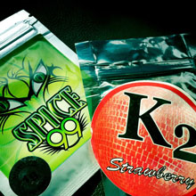
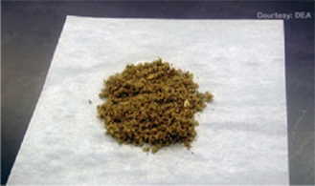
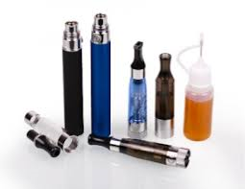
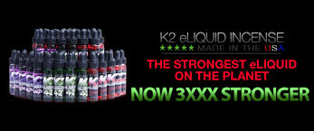

Slide 29
Tobacco and Pregnancy
Why is it can be so difficult to quit
Tobacco is a substance that is both physiological and psychologically addictive.
Many times smoking helps keep people away from using more dangerous substances.

Slide 30
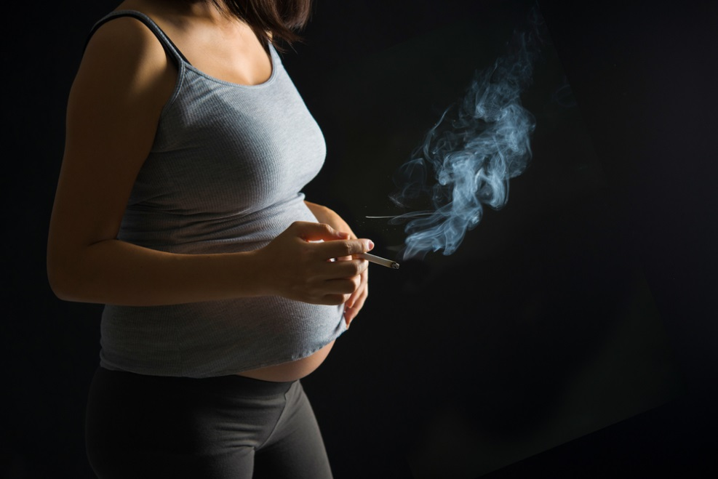
Tobacco and Pregnancy
Impact of Tobacco on the Infant (Increases risk)
Low birth weight
Smaller head and chest circumference
SIDS
Asthma
Obesity
Cleft palate
CNS Problems
Impact of Tobacco on Mother
Problems with the placenta
Preterm premature rupture of amniotic sac
Premature birth
Abnormal bleeding
Pregnancy loss

Slide 31
Tobacco and Pregnancy
How to help pregnant patients find motivation for quitting:
Core MI Skills (OARS)
Open-Ended Questions
Affirmations
Reflections
Summaries
Change Talk!

Slide 32
Taking a patient history
Always ask permission before asking a Patient about their substance use
Normalize the questions
This is routine screening for all patients, including those who are pregnant
Let the Patient know that they will be asked these questions at each prenatal visit
Use open-ended questions to ask about previous substance use
Avoid asking why questions- They make people defensive
Try to avoid yes/no questions- If you do ask one, follow-up with an open-ended question
If Patient is using substances, be ready to use a brief negotiated interview (BNI) and offer non-judgmental support and resources
Thank the Patient for their openness and honesty, given the difficulty of discussing this sensitive topic

Slide 33
Expected Duration for a positive urine drug screen
AMPHETAMINE 2 - 4 DAYS
METHAMPHETAMINE 2 - 4 DAYS
BARBITURATES (SHORT ACTING) 2 - 4 DAYS
BARBITURATES (LONG ACTING) UP TO 30 DAYS
BENZODIAZEPINES UP TO 30 DAYS
COCAINE 1 - 3 DAYS
HEROIN/MORPHINE 1 - 3 DAYS
MARIJUANA (CHRONIC USE) UP TO 30 DAYS
MARIJUANA ( OCCASIONAL USE) 1 - 3 DAYS
METHADONE 2 - 4 DAYS
PCP (CHRONIC USE) UP TO 30 DAYS
PCP (OCCASIONAL USE) 2 - 7 DAYS

Slide 34
Treatment options
Outpatient individual counseling- Patient meets with counselor and discusses various topics including coping skills, interpersonal relationships, psychiatric disorders and substance use.
Outpatient group counseling- A group of patients meet to share information about their own lives and give feedback to other patients in a setting facilitated by a group leader. Groups often focus on topics like Anger Management, Relapse Prevention and Harm Reduction.
Adult day treatment program- Patients can attend a day program that includes group and individual counseling, recreation activities, daily meals and medical care.
Medication Assisted Therapy (MAT)- Combination of behavioral therapy and medications to treat substance use disorders, for example Methadone or Buprenorphine, or Naltrexone.
Detox- Detox can occur inpatient or outpatient and is done under the supervision of medical staff to monitor withdrawal symptoms. Always needed for Patient withdrawing from alcohol due to delirium tremens.
28-day program- Patient lives in the rehabilitation center for 28 days and attends individual and group therapy sessions.

Slide 35
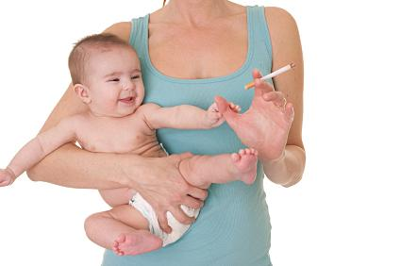
Additional supports for post-partum Patient using substances
Provider should pay close attention to Patient for post-partum depression
Provider should be supportive of Patient as taking care of a newborn while attending a day program is very demanding
Patient may have ACS involvement
Care team should offer homemaker
services if needed
Provider should discuss substance use while around the baby and especially if patient is breastfeeding

Slide 36
Learning into practice: Role play

